Slide 1
Data Mining Anomaly Detection Dr. Lov Kumar Assistant Professor, BITS Pilani, Hyderabad Campus

Slide 2
Anomaly/Outlier Detection
What are anomalies/outliers?
The set of data points that are considerably different than the remainder of the data
Variants of Anomaly/Outlier Detection Problems
Given a database D, find all the data points x ∈ D with anomaly scores greater than some threshold t
Given a database D, find all the data points x ∈ D having the top-n largest anomaly scores f(x)
Given a database D, containing mostly normal (but unlabeled) data points, and a test point x, compute the anomaly score of x with respect to D
Applications:
Credit card fraud detection, telecommunication fraud detection, network intrusion detection, fault detection

Slide 3
Anomaly Detection
Challenges
How many outliers are there in the data?
Method is unsupervised
Validation can be quite challenging (just like for clustering)
Working assumption:
There are considerably more “normal” observations than “abnormal” observations (outliers/anomalies) in the data

Slide 4
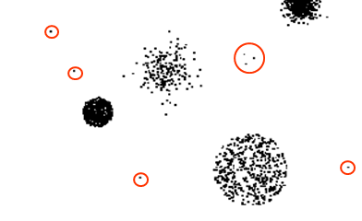
General Steps
Build a profile of the “normal” behavior
Profile can be patterns or summary statistics for the overall population
Use the “normal” profile to detect anomalies
Anomalies are observations whose characteristics differ significantly from the normal profile
Types of anomaly detection schemes
Graphical & Statistical-based
Distance-based
Model-based

Slide 5
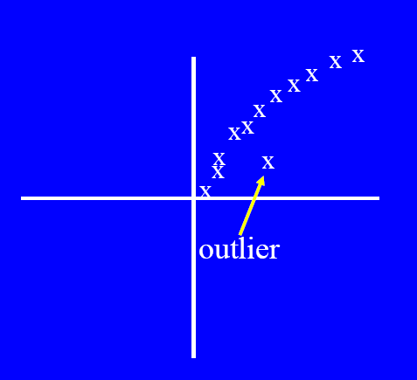
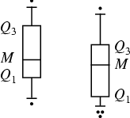
Boxplot (1-D), Scatter plot (2-D), Spin plot (3-D)

Slide 6
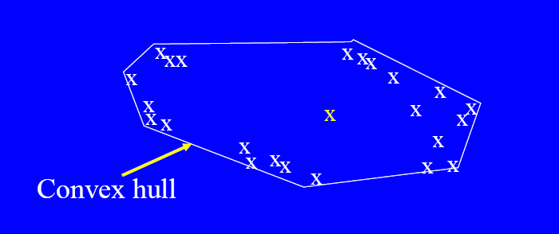
Convex Hull Method
Extreme points are assumed to be outliers Use convex hull method to detect extreme values

Slide 7
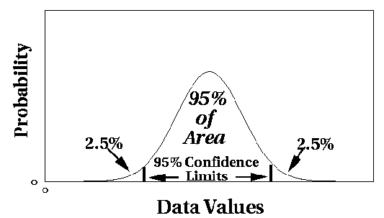
Statistical Approaches
Assume a parametric model describing the distribution of the data (e.g., normal distribution)
Apply a statistical test that depends on
Data distribution
Parameter of distribution (e.g., mean, variance)
Number of expected outliers (confidence limit)

Slide 8
Grubbs’ Test
Detect outliers in univariate data
Assume data comes from normal distribution
Detects one outlier at a time, remove the outlier, and repeat
H0: There is no outlier in data
HA: There is at least one outlier
Grubbs’ test statistic:
Reject H0 if:

Slide 9
Distance-based Approaches
Data is represented as a vector of features
Three major approaches
Nearest-neighbor based
Density based
Clustering based

Slide 10
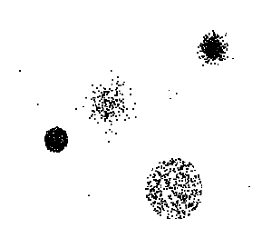
Clustering-Based
Basic idea:
Cluster the data into groups of different density
Choose points in small cluster as candidate outliers
Compute the distance between candidate points and non-candidate clusters.
If candidate points are far from all other non-candidate points, they are outliers

Slide 11
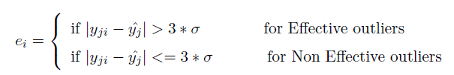
Box-plot
Effectiveness of outliers is examined by using the following equation
Or
Lower Limit = Q1 – 1.5 IQR.
Upper Limit = Q3 + 1.5 IQR
IQR=Q3-Q1

Slide 12
